Slide 1
NT21

Slide 2
Week 1 : Introduction (Networks, Layered Model, Linux) Week 2 : IP Protocol, IP Addressing, IP Subnets , ARP, Netkit Week 3 : IP Routing, ICMP Week 4 : TCP/UDP Week 5 : Sockets Week 6 : NAT, DHCP, DNS Week 7 : Repetition
Program

Slide 3
Layered Communication: TCP/IP Protocols Overview
Application Layer
HTTP
DNS
FTP
DHCP
DHCP
Telnet
SMTP
Transport Layer
TCP
UDP
Network Layer
IP
DataLink Layer
Ethernet
Wifi
Bluetooth
Physical Layer
Ethernet
Wifi
Bluetooth

Slide 4
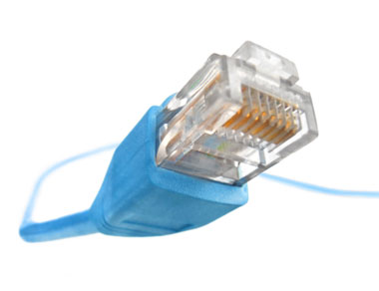
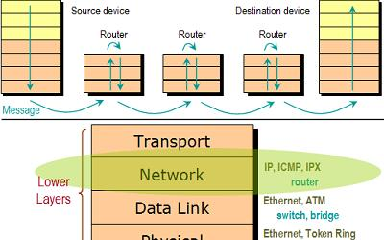
IP Protocol
Layer 3 (Network layer) Protocol
Connectionless Protocol
Unreliable
Best Effort Service
Delivers Datagrams
Responsible for Routing
Notes:
A datagram is a basic transfer unit associated with a packet-switched network. Datagrams are typically structured in header and payload sections. Datagramsprovide a connectionless communication service across a packet-switched network. (source: https://en.wikipedia.org/wiki/Datagram)

Slide 5
IP Addressing
192.168.1.125
192
168
1
125
11000000
1010100
00000001
01111101
32 bits

Slide 6
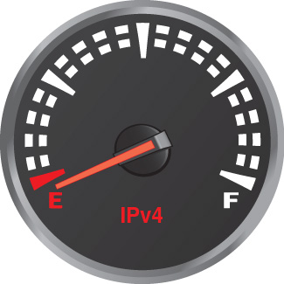
IP Addressing
IPv4 :
2³² = 4 294 967 296 addresses

Slide 7
IP Addressing/Subnetting
192.168.1.125/24
192
168
1
125
Network id
Host id
Notes:
Size of network id and host id are flexible but together they have to be 32 bits

Slide 8
IP Classful Addressing
History :
Network ID was 8 bits
How many hosts could we then address ?
2²⁴-2
… but only 2⁸ (255) subnets

Slide 9
IP Classful Addressing
Later :
To accommodate more networks Classful Addressing was used
More flexibility in the number of networks to be used

Slide 10
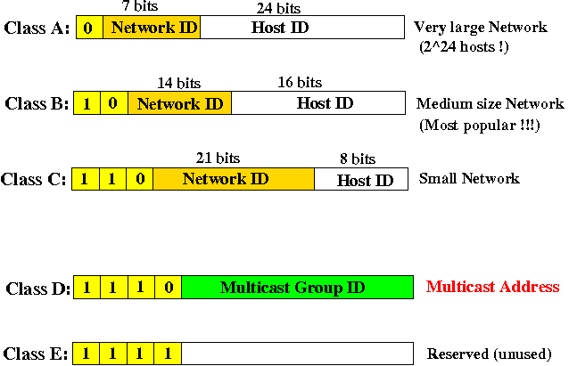
IP Classful Addressing

Slide 11
IP Addressing
Now :
To allow even more flexibility in IP addressing
IP Classless Addressing

Slide 12
IP CIDR (Classless Inter Domain Routing) Addressing
192.68.1.125/24
192
68
1
125
Network id
Host id
Subnet Mask :
11111111.11111111.11111111.00000000

Slide 13
IP Addressing/Subnetting
192.68.1.125/255.255.255.0
=
192.68.1.125/24
192
68
1
125
Network id
Host id
Subnet Mask :
11111111.11111111.11111111.00000000
or
255.255.255.0
Notes:
Subnet Mask determines the network part of the address. In this case, it is the first 3 bytes of the address (24 bits). The remaining bits belong to host id.

Slide 14
IP Addressing
Host ID consisting of all 0s or all 1s are special, they can’t be used for assigning a host
Host id consisting of all 0s is used to assign the whole network, in our example it is : 192.168.1.0
Host id consisting of all 1s is used to assign broadcast address, in our example it is : 192.168.1.255
Notes:
So how many devices can be connected to a network with subnet mask 255.255.255.0 ?

Slide 15
IP Subnetting
192.168.1.125/24
192
168
1
125
Network id
Host id
11000000
10101000
00000001
01111101
&
11111111
11111111
11111111
00000000
Network :
192.168.1.0/24 (host id all 0’s)
Hosts :
2^{n}-2 = 2⁸-2 = 254
Broadcast:
192.168.1.255 (host id all 1’s)
n is number of host id bits

Slide 16
IP Subnetting – Another Example
146.22.33.1/20
=
146.22.33.1/255.255.240.0
146
22
33
1
Network id
Host id
1001 0010
0001 0110
0010 0001
0000 0001
&
1111 1111
1111 1111
1111 0000
0000 0000
Network :
Broadcast:
146.22.47.255 (host id all 1’s)
146.22.32.0/20 (host id all 0’s)
Hosts :
2^{n}-2 = 2¹²-2 = 4094
Host Id:
257
n is number of host id bits

Slide 17
IP Addressing
Special Address Ranges :
10.0.0.0/8 (private networks)
192.168.0.0/16 (private networks)
172.16.0.0/12 (private networks)
169.254.0.0/16 (link-local addresses)
127.0.0.0/8 (loopback addresses)
Notes:
Note : We will talk about private network when dealing with NAT

Slide 18
ARP: Address Resolution Protocol
ARP does address resolution between an IP address and hardware MAC address within LAN network

Slide 19
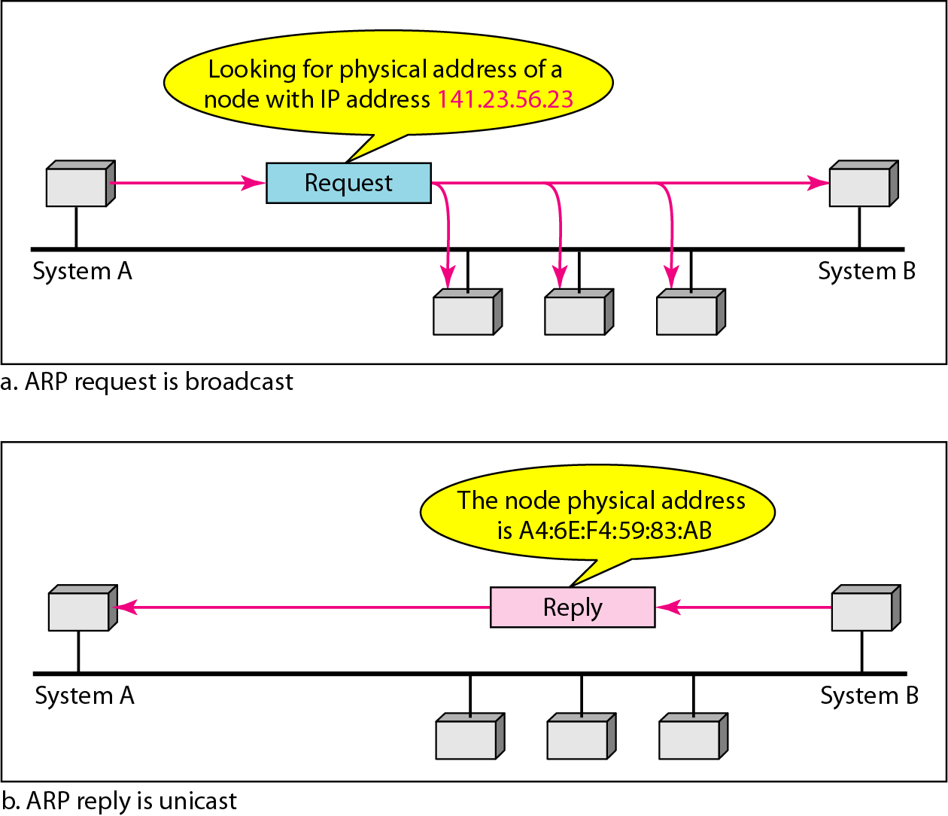
ARP Protocol

Slide 20

Several useful Linux networking commands
Configure network interfaces:
ifconfig command
Example:
ifconfig eth0 192.168.1.2 netmask 255.255.255.0
Configure eth0 interface with an IP address and subnet mask.
ifconfig -a
Show all network interfaces of this machine.

Slide 21
Several useful Linux networking commands
Configure network interfaces:
ip command
Example:
ip addr add 192.168.1.2/24 dev eth0
Configure eth0 interface with an IP address and subnet mask.
ip addr show
Show all network interfaces of this machine.

Slide 22
Several useful Linux networking commands
Manipulate the system arp cache:
arp command
Example:
arp
Show current ARP cache entries.
arp –d 192.168.1.1
Delete ARP cache entry for the IP address 192.168.1.1.

Slide 23
Several useful Linux networking commands
Network Diagnosis:
ping command
Example:
ping 192.168.1.1
Send ICMP Echo Request (ping) to 192.168.1.1 to see whether the node 192.168.1.1 is alive.

Slide 24
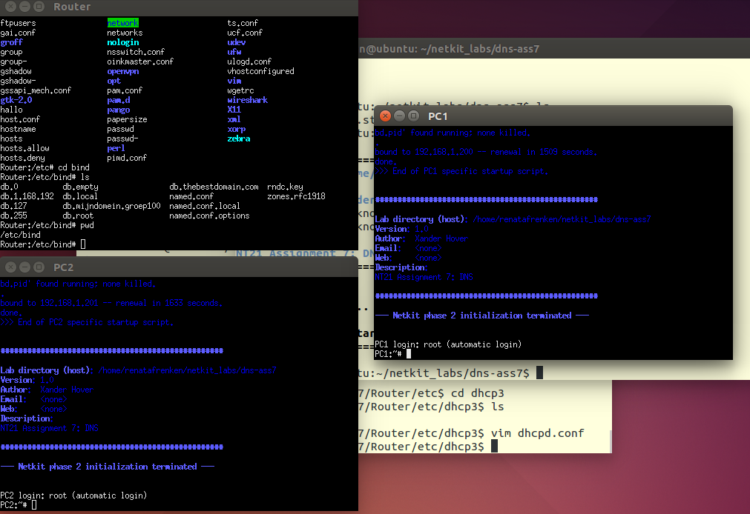
Netkit
The poor man’s system to experiment computer networking.

Slide 25
Netkit
Uses User Mode Linux (UML) to simulate network nodes
Virtual machines are connected through virtual data network
Virtual machines can be configured to run network clients, servers, switches or routers

Slide 26
Netkit basics
Create and start a virtual machine:
vstart command
Example:
vstart PC1 --eth0=A
vstart PC2 --eth0=A
Start two VMs named PC1 and PC2 which are connected to a collision domain (LAN) named A.

Slide 27
Netkit basics
Halt a virtual machine:
vhalt command
Example:
vhalt PC1
vhalt PC2
Gracefully shuts down VMs named PC1 and PC2.

Slide 28
Netkit basics
List running virtual machines:
vlist command
Example:
vlist
Shows information about all currently running virtual machines.

Slide 29
Netkit basics
Help about all netkit commands can be found by using Linux command man
man command
Example:
man lstart
Shows the manual pages for the netkit lstart command.

Slide 30
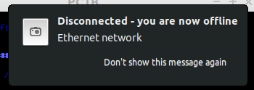
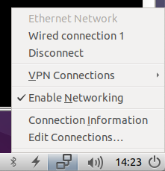
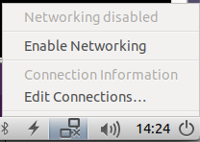
Netkit freezing up?!
Try to disable networking in your Linux virtual machine:

